Slide 1


IPL AUCTION 2020

Slide 2
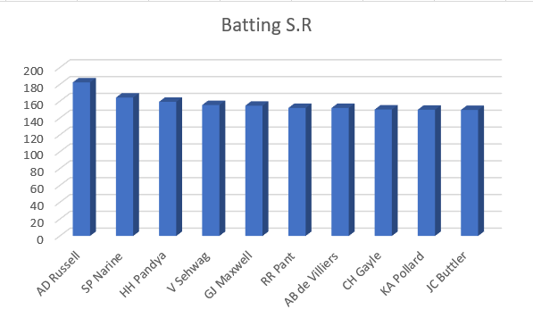
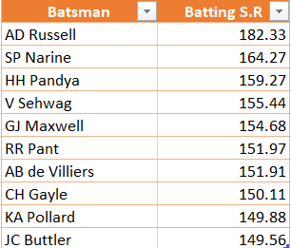
List of 10 batsman with high batting strike rate who have faced atleast 500 balls
SQL QUERY -
SELECT
batsman,
ROUND((SUM(batsman_runs)*1.0 / COUNT(ball)) * 100,2) AS batsman_sr
FROM ipl_ball
WHERE
extras_type not in ('wides')
GROUP BY
batsman
HAVING
COUNT(ball) > 500
ORDER BY
batsman_sr DESC
LIMIT 10;

Slide 3
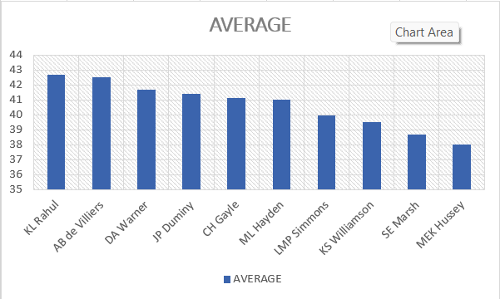
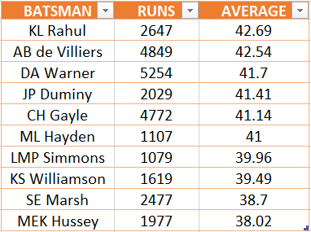
List of 10 players with best average who have played more than 2 IPL seasons (or 28 matches)
SQL QUERY-
SELECT
batsman,
SUM(batsman_runs) AS runs,
ROUND(SUM(batsman_runs)*1.0/SUM(is_wicket),2) AS average
FROM ipl_ball
GROUP BY
batsman
HAVING
SUM(is_wicket) > 0 AND COUNT(DISTINCT id) > 28
ORDER BY
average DESC
LIMIT 10;

Slide 4
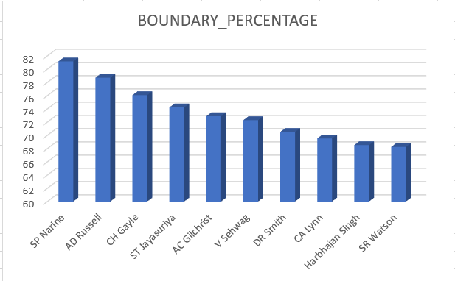
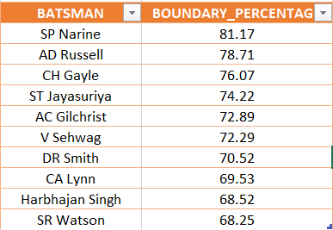
List of 10 players who have scored most runs in boundaries and have played more than 2 IPL seasons which is more than 28 matches.
SQL QUERY-
SELECT
batsman,
ROUND(SUM(CASE WHEN batsman_runs in(4,6) THEN batsman_runs else 0 END)*1.0 / SUM(batsman_runs)*100,2) AS boundary_percentage
FROM ipl_ball
WHERE
extras_type NOT IN ('wides')
GROUP BY
batsman
HAVING
COUNT(DISTINCT id) > 28
ORDER BY
boundary_percentage DESC
LIMIT 10;

Slide 5
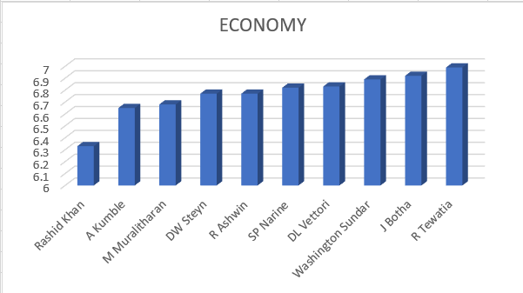
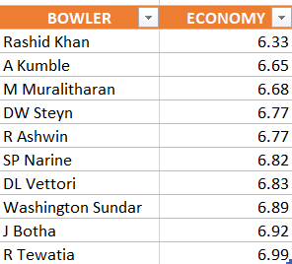
List of 10 bowlers with best economy who have bowled at least 500 balls in IPL
SQL QUERY-
SELECT
bowler,
ROUND(SUM(total_runs)/(COUNT(bowler)/6.0), 2)
as economy
FROM ipl_ball
GROUP BY
bowler
HAVING
COUNT(bowler) > 500
ORDER BY
economy
LIMIT 10;

Slide 6
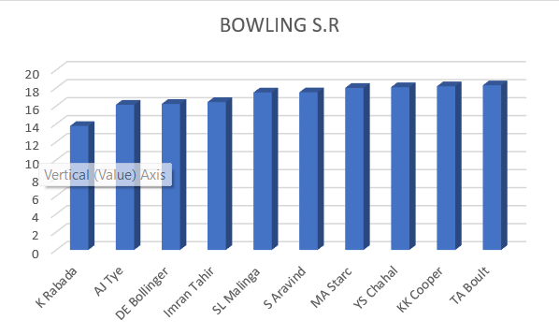
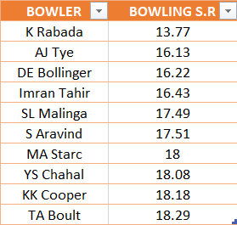
List of 10 bowlers who have the best strike rate and who gave bowled at least 500 balls.
SQL QUERY-
WITH ValidDismissals AS (
SELECT
bowler,
is_wicket,
CASE
WHEN dismissal_kind IN ('bowled', 'caught', 'caught and bowled', 'hit wicket', 'lbw', 'stumped')
THEN 1
ELSE 0
END AS is_valid_dismissal
FROM ipl_ball
)
SELECT
bowler,
ROUND(COUNT(bowler) * 1.0 / SUM(is_valid_dismissal),2) AS economy
FROM
ValidDismissals
GROUP BY
bowler
HAVING
COUNT(bowler) > 500
ORDER BY
economy
LIMIT 10;

Slide 7
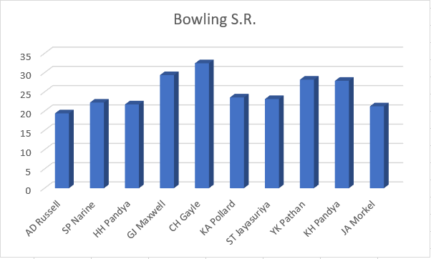
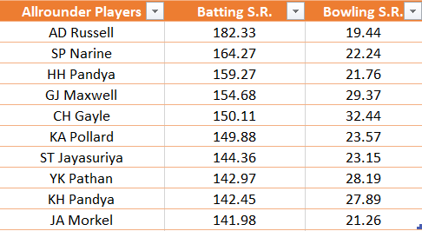
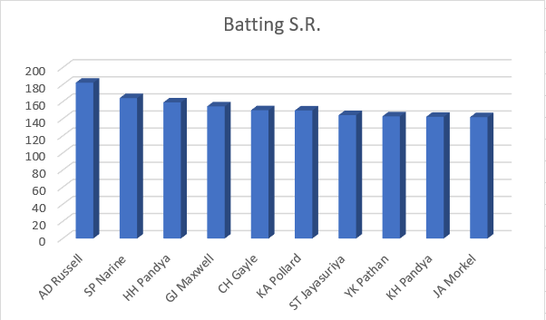
List of 10 allrounders who have the best bowling and batting strike rate and who gave faced at least 500 balls and bowled at least 300 balls.
SQL QUERY-
SELECT
a.batsman AS all_rounder,
a.batsman_sr,
b.bowling_sr
FROM batting_sr a
INNER JOIN
bowling_sr b ON a.batsman = b.bowler
ORDER BY
a.batsman_sr DESC,
b.bowling_sr ASC
LIMIT 10;

Slide 8
Criteria for selecting WICKETKEEPERS in the IPL.
1) Batting Performance: Wicketkeepers who can score quickly and hit boundaries, contributing to the team's run total.
2) Reflexes: Wicketkeepers with quick reflexes, clean catching ability, and accurate stumpings.
3) Experience: Wicketkeepers with T20 experience who can handle pressure situations effectively and guide team calmly.
4) Leadership And Motivation: Wicketkeepers who can lead the fielding unit and effectively communicate with bowlers and fielders are valuable. Plays important role in supporting captain.
5) Fielding Capability: Wicketkeepers with excellent fielding skills, capable of creating run-out opportunities. Plays vital role in making strategies.
6) Accuracy In Game: Wicketkeepers with a consistent track record, both in batting and wicketkeeping, to ensure stable performance throughout the tournament.

Slide 9
Additional Questions for Final Assessment →

Slide 10
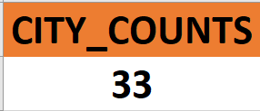
1. Get the count of cities that have hosted an IPL match.
Select count(distinct city)
as cities
From ipl_matches;

Slide 11
2. Create table deliveries_v02 with all the columns of the table ‘deliveries’ and an additional column ball_result containing values boundary, dot or other depending on the total_run (boundary for >= 4, dot for 0 and other for any other number)
CREATE TABLE deliveries_v02 AS
SELECT *,
CASE
WHEN total_runs >= 4 THEN 'boundary’
WHEN total_runs = 0 THEN 'dot’
ELSE 'other’
END AS ball_result
FROM ipl_ball;

Slide 12

3. Write a query to fetch the total number of boundaries and dot balls from the deliveries_v02 table.
Select ball_result,count(ball_result as dots_and_boundries
from deliveries_v02 where ball result in(‘boundry’,’dot’) group by ball_result;

Slide 13
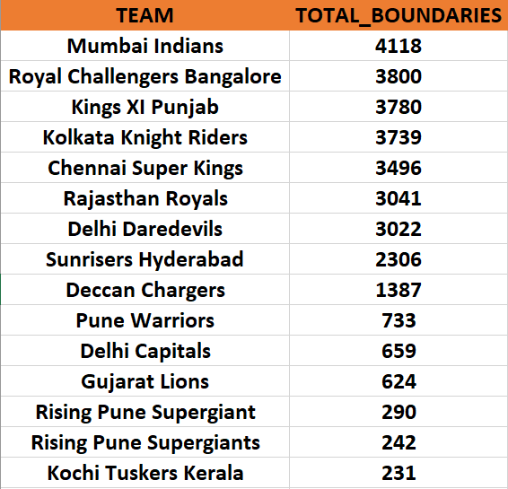
4. Write a query to fetch the total number of boundaries scored by each team from the deliveries_v02 table and order it in descending order of the number of boundaries scored.
Select batting_team, count(ball_result) as no_boundries
From deliveries_v02
Where ball_result =‘boundry’
Group by batting_team order by no_boundries desc;

Slide 14
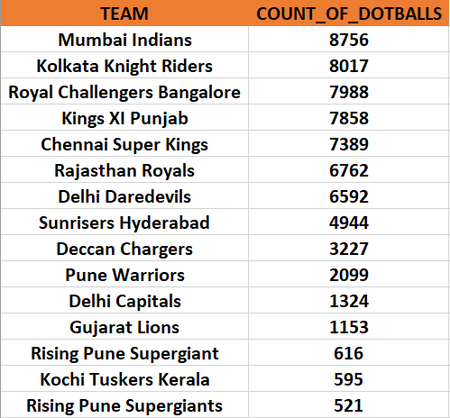
5. Write a query to fetch the total number of dot balls bowled by each team and order it in descending order of the total number of dot balls bowled.
Select bowling_team, count(ball_result) as dot_balls
From deliveries_v02
Where ball_result= ‘dot’
Group by bowling_team order by dot_balls desc;

Slide 15

6. Write a query to fetch the total number of dismissals by dismissal kinds where dismissal kind is not NA
Select dismissal_kind, count (dismissal_kind) as dismissal_kind
From deliveries_v02
Where dismissal_kind != ‘NA’
Group by dismissal_kind;

Slide 16
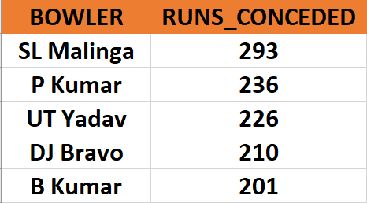
7. Write a query to get the top 5 bowlers who conceded maximum extra runs from the deliveries table
Select bowler ,sum(extra_runs) as extra_run_conceded
From deliveries_v02
Group by bowler
Order by extra_run_conceded desc
Limit 5;

Slide 17
8. Write a query to create a table named deliveries_v03 with all the columns of deliveries_v02 table and two additional column (named venue and match_date) of venue and date from table matches
CREATE TABLE deliveries_v03 AS
SELECT
d.*,
m.venue,
EXTRACT(DAY FROM m.date) AS date
FROM deliveries_v02 d
LEFT JOIN
ipl_match m ON d.id = m.id;

Slide 18
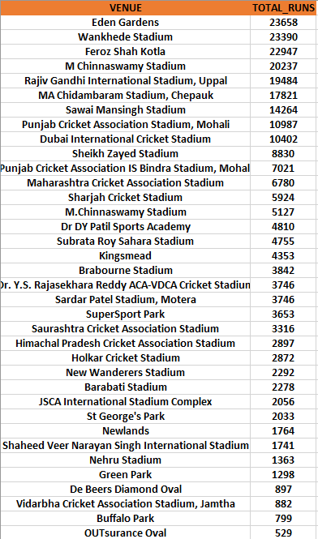
9. Write a query to fetch the total runs scored for each venue and order it in the descending order of total runs scored.
Select venue, sum(total_runs) as total_runs
From deliveries_v03
Group by venue
Order by total_runs desc;

Slide 19
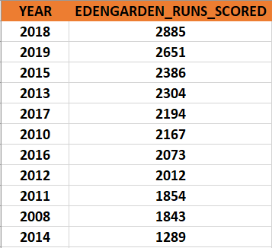
10. Write a query to fetch the year-wise total runs scored at Eden Gardens and order it in the descending order of total runs scored.
Select extract(year from data), sum(total_runs) as total_runs_scored
From deliveries_v03
Where venue= ‘Eden Gardens’
Group by extract(year from data) order by total_runs_scored desc;

Slide 20
Thank You

